Slide 1
Preliminary results CONVENTIONAL rotation E26 (2018-2022) Plot 1
17/10/2024

Slide 2
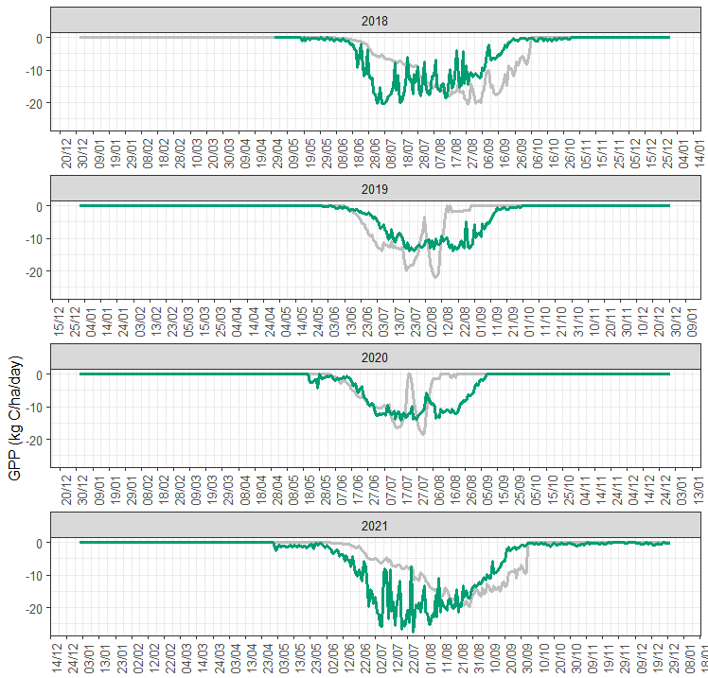
Issues discussed last Friday:
corn
1) Potential to improve fit of GPP during corn years.
soybeans
2) Sharp decrease in GPP in soybean years.
soybeans
2) Sharp decrease in GPP in soybean years.
corn
1) Potential to improve fit of GPP during corn years.

Slide 3
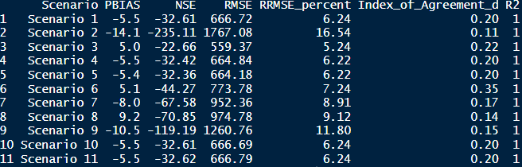
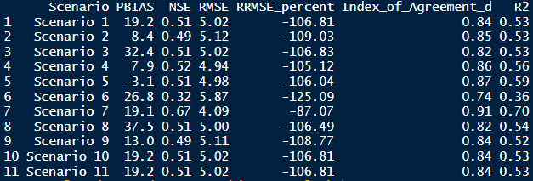
For issue 1, I run a series of scenarios for the corn years (2018 & 2021) to test potential improvements:
 | 1 | 2 | 3 | 4 | 5 | 6 | 7 | 8 | 9 | 10 | 11
maximum yield | 5000 | 5500 | 4500
leaf fraction | 0.19 |  |  | 0.21 | 0.23
stem fraction | 0.19 |  |  | 0.21 | 0.23
root fraction | 0.15 |  |  | 0.15 | 0.15
grain fraction | 0.47 |  |  | 0.43 | 0.39
accumulative temperature | 2500 |  |  |  |  | 2750 | 2250
optimum temperature | 29.7 |  |  |  |  |  |  | 32.7 | 26.7
water requirement | 150 |  |  |  |  |  |  |  |  | 165 | 135
Results for yield:
Increasing max yield seems to improve yield fit.
Results for gpp:
Decreasing accumulative temp seems to improve fit.
Scenario 7 seems better for GPP, although yield shows worse metrics for that scenario; what is a reasonable compromise here? Maybe to go with scenario 7?

Slide 4
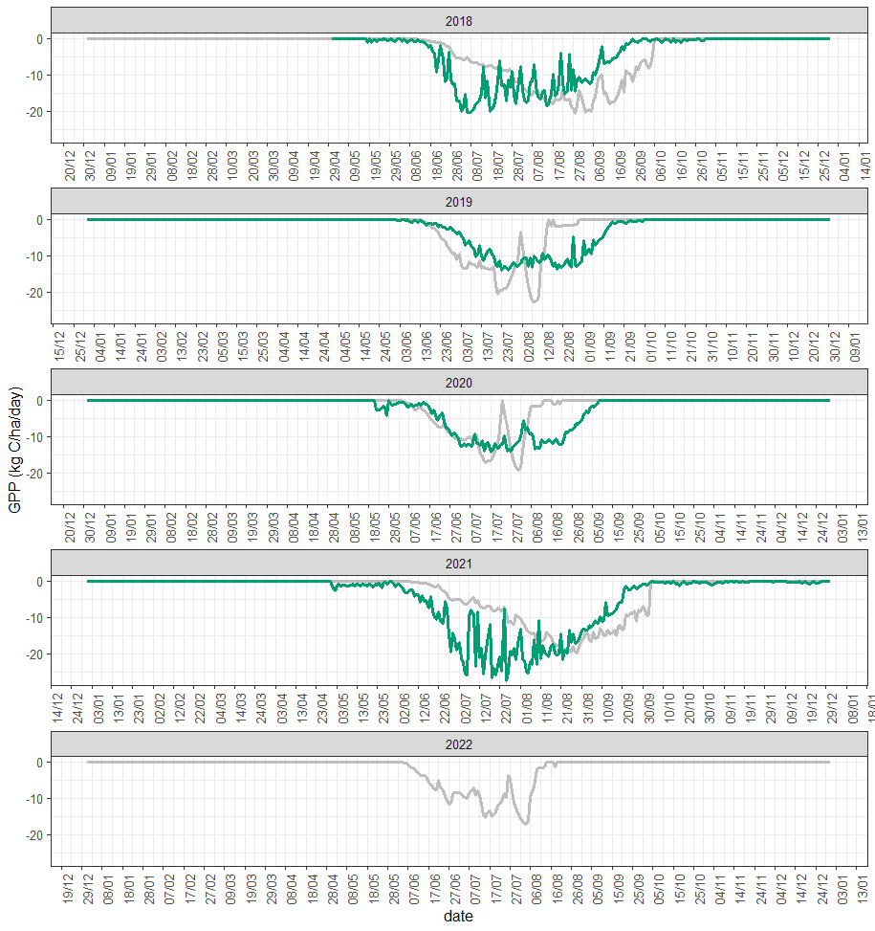


GPP for scenario 1:
GPP for scenario 3:
GPP for scenario 7:
Maybe even in scenario 7 there is still opportunities to achieve a better fit?

Slide 5
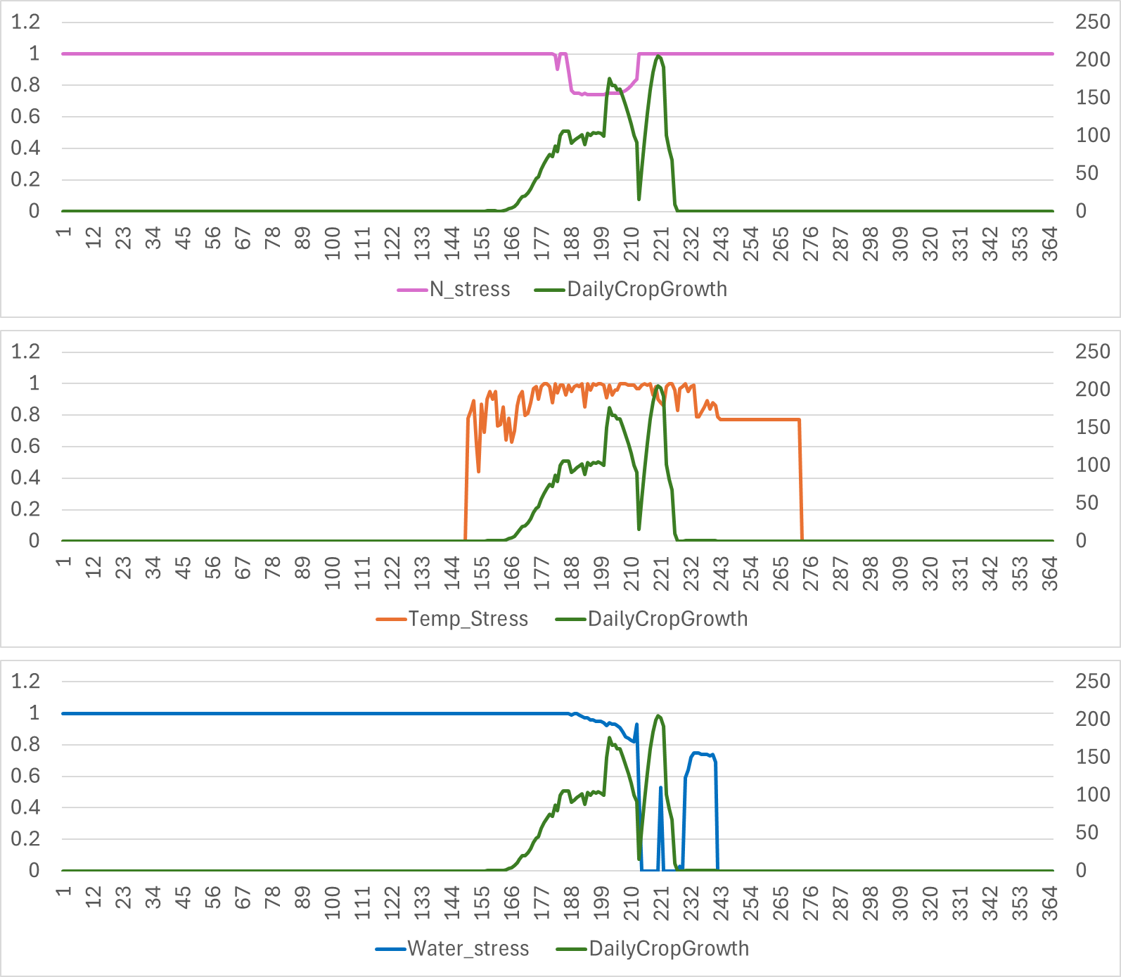
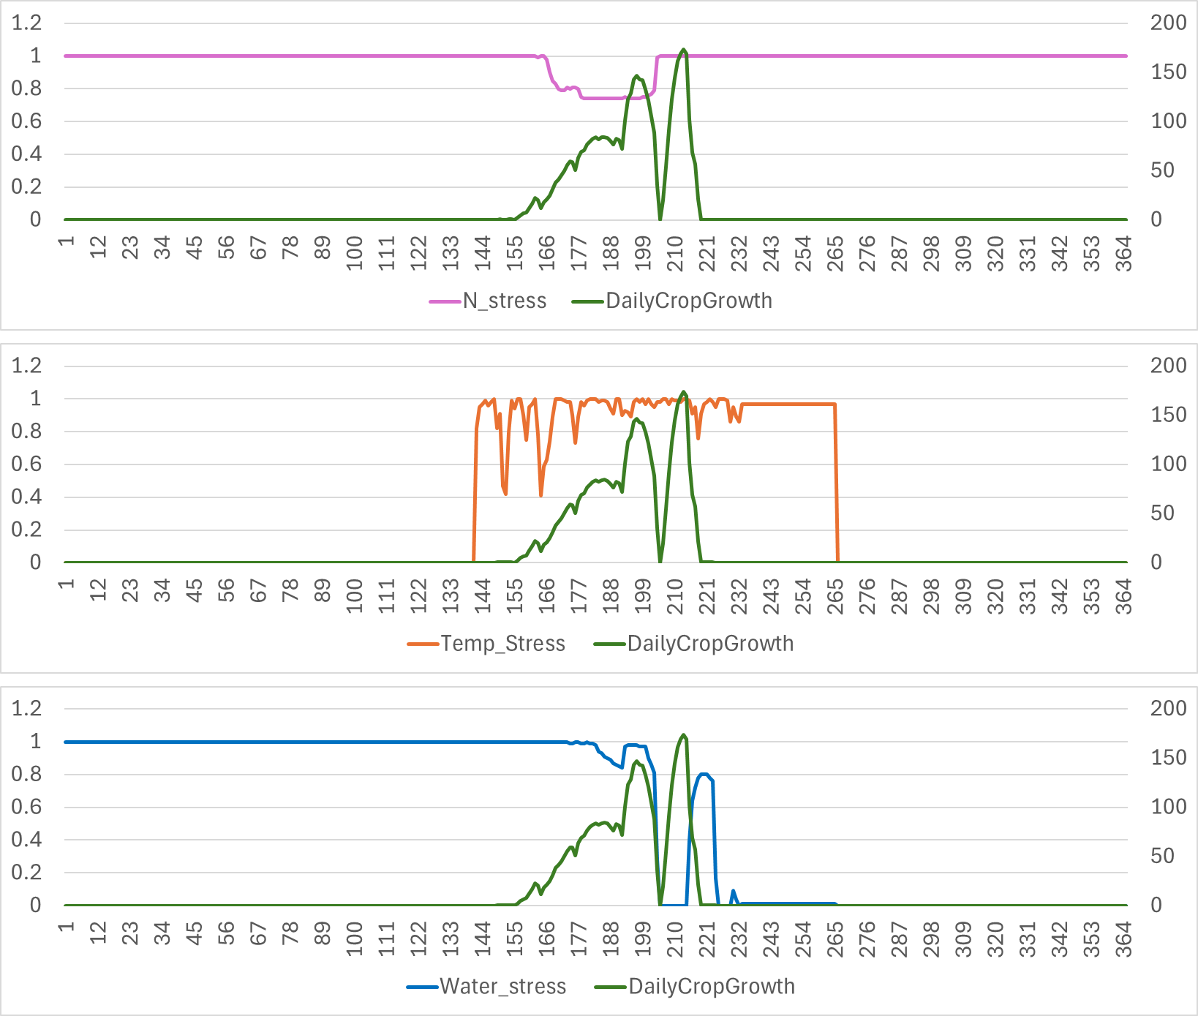
For issue 2, I explored changes in crop stress indexes and crop growth
Index
Soybean 2019
Crop growth
Index
Soybean 2020
Crop growth
In both years, it seems to be associated with water stress.
However, variables like soil water content do not seem to be particurlarly associated with this stop in growth.
Do you know how the index is calculated? I thought it could give insights into what might be the problem

Slide 6
Additional questions:
Weather data
What input does DNDC need for wind data? Speed at 2 m or at 10 m?
For precipitation, should it be total precipitation, or rain only?
Do you always set up the spin up as a single set of management practices in DNDC? Is the management of the spin-up approximately what happened in the field in the 10 years prior to modeling the experiment of interest?
In your .dnd file seems like the value for crop residue harvested varies between 0.75 and 1 for most crops; what does that depend on?
For UAN applications, I see you splitted things in 25% nitrate, 50% urea and 12.5 ammonium; is that for the split of UAN?
Do you normally switch on the "Dynamic Water Table <2" in the soil's tab of DNDC? In one of the files you shared you indicated this was used when tile drainage was present, which is the case for Elora.

